Slide 1
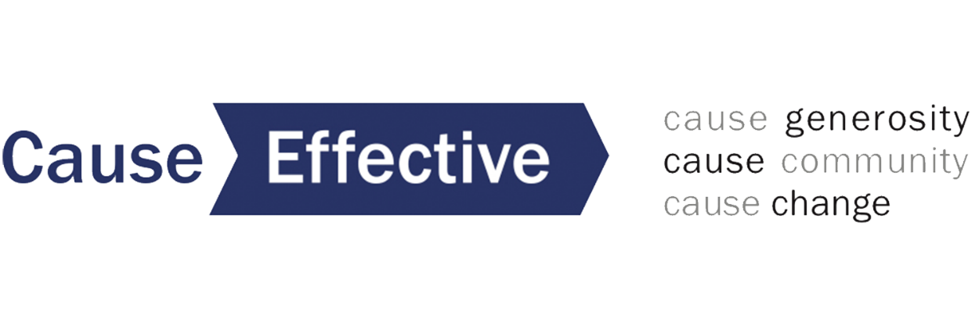
Cause Effective serves as a
nonprofit growth partner
to help organizations build the effectiveness of their fundraising strategy and governance practices

Slide 2
We offer:
responsive organizational support
assessment of your fundraising strategy and guidance on executing new tactics to sustain and grow
individual coaching of development staff, executive directors and board leaders
workshops that draw on our decades of expertise
thought leadership to the field on issues of DEI as it relates to fundraising and philanthropy

Slide 3
Some of the fundraising concerns we’re helping groups address in recent months are:
Loss of revenue due to cancelled special events and fundraising campaigns
Uncertainty of the appropriate time to ask donors for financial support
Struggles with how to message the organization’s case for support and inspire donor engagement
Inability to conduct in-person donor cultivation during a time of social distancing
Learning to utilize digital platforms to conduct events for the first time

Slide 4
And we’re having higher-level strategy conversations as well, focused on:
What is the essential goal of your fundraising program in this extraordinary year –
and how can you achieve that goal through different strategies than you have used in the past?
​

Slide 5
​
Fundraising Under COVID:
What have we lost?
Face Time
Donor Focus
Organizational Focus
Internal Capacity
More…

Slide 6
​Fundraising Under COVID:
What have we gained?
Burning Clarity of Mission
Ability to Have Impact
Positivity
Connection to Values
Geographic Reach
More…
​

Slide 7
​Cultivation is 90% of the Fundraising Process
How can you share the face of your organization when the shape of your presence has changed?
Fundraising is an Exchange
​

